Slide 1
API(application Programming Interface)
API is a document that contains description of all the features of a product or software.
It represents classes and interfaces that software programs can follow to communicate with each other.
An API can be created for applications, libraries, operating systems, etc

Slide 2
JDBC (Java Database Connectivity)
DBC stands for Java Database Connectivity.
JDBC is an interface that can be used by Java applications to access databases.
JDBC is a Java API to connect and execute the query with the database.
It is a part of JavaSE (Java Standard Edition). JDBC API uses JDBC drivers to connect with the database.
There are four types of JDBC drivers:
JDBC-ODBC Bridge Driver,
Native Driver,
Network Protocol Driver, and
Thin Driver

Slide 3
Contd…
We can use JDBC API to access tabular data stored in any relational database.
By the help of JDBC API, we can save, update, delete and fetch data from the database.
It is like Open Database Connectivity (ODBC) provided by Microsoft.

Slide 4
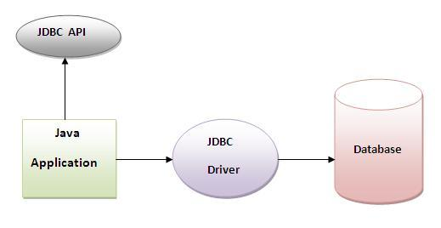
JDBC Diagram

Slide 5
Contd…
It is based on the X/Open SQL Call Level Interface.
The java.sql package contains classes and interfaces for JDBC API.
A list of popular interfaces of JDBC API are given below:
Driver interface
Connection interface
Statement interface
PreparedStatement interface
CallableStatement interface
ResultSet interface
RowSet interface

Slide 6
Contd…
A list of popular classes of JDBC API are given below:
DriverManager class
Blob class
Clob class
Types class

Slide 7
Use of jdbc
JDBC API can use to handle database using Java program and can perform the following activities:
Connect to the database
Execute queries and update statements to the database
Retrieve the result received from the database.

Slide 8
JDBC Driver
JDBC Driver is a software component that enables java application to interact with the database.
There are 4 types of JDBC drivers:
JDBC-ODBC bridge driver
Native-API driver (partially java driver)
Network Protocol driver (fully java driver)
Thin driver (fully java driver)

Slide 9
JDBC-ODBC bridge driver
The JDBC-ODBC bridge driver uses ODBC driver to connect to the database.
The JDBC-ODBC bridge driver converts JDBC method calls into the ODBC function calls. This is now discouraged because of thin driver.
Oracle does not support the JDBC-ODBC Bridge from Java 8. Oracle recommends that you use JDBC drivers provided by the vendor of your database instead of the JDBC-ODBC Bridge.

Slide 10
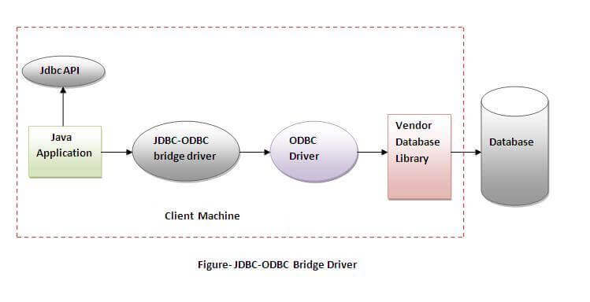
Contd…

Slide 11
Contd…
Advantages:
easy to use.
can be easily connected to any database.
Disadvantages:
Performance degraded because JDBC method call is converted into the ODBC function calls.
The ODBC driver needs to be installed on the client machine.

Slide 12
Native-api Driver
The Native API driver uses the client-side libraries of the database.
The driver converts JDBC method calls into native calls of the database API.
It is not written entirely in java.

Slide 13
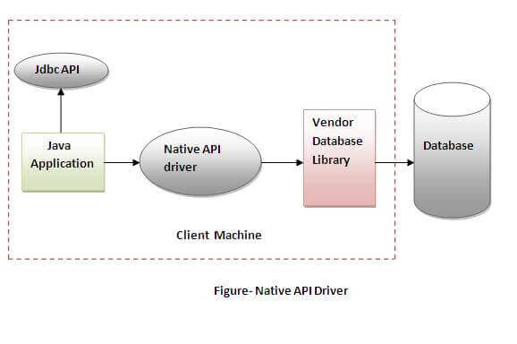
Contd…

Slide 14
Contd…
Advantage:
performance upgraded than JDBC-ODBC bridge driver.
Disadvantage:
The Native driver needs to be installed on the each client machine.
The Vendor client library needs to be installed on client machine.

Slide 15
Network Protocol Driver
The Network Protocol driver uses middleware (application server) that converts JDBC calls directly or indirectly into the vendor-specific database protocol.
It is fully written in java.

Slide 16
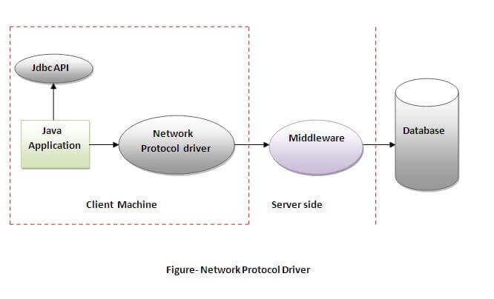
Contd…

Slide 17
Contd…
Advantage:
No client side library is required because of application server that can perform many tasks like auditing, load balancing, logging etc.
Disadvantages:
Network support is required on client machine.
Requires database-specific coding to be done in the middle tier.
Maintenance of Network Protocol driver becomes costly because it requires database-specific coding to be done in the middle tier.

Slide 18
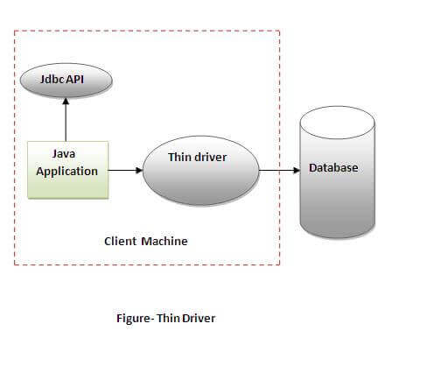
Thin Driver
The thin driver converts JDBC calls directly into the vendor-specific database protocol. That is why it is known as thin driver. It is fully written in Java language.

Slide 19
Contd…
Advantage:
Better performance than all other drivers.
No software is required at client side or server side.
Disadvantage:
Drivers depend on the Database.

Slide 20
Steps To Connect To The Database In Java
There are 5 steps to connect any java application with the database in java using JDBC.
Register the driver class
Creating connection
Creating statement
Executing queries
Closing connection

Slide 21
1) Register the driver class
The forName() method of Class class is used to register the driver class. This method is used to dynamically load the driver class.
Syntax of forName() method
public static void forName(String className)throws ClassNotFoundException
Example to register the OracleDriver class
Class.forName("oracle.jdbc.driver.OracleDriver");

Slide 22
2) Create the connection object
The getConnection() method of DriverManager class is used to establish connection with the database.
Syntax of getConnection() method
1) public static Connection getConnection(String url)throws SQLException
2) public static Connection getConnection(String url,String name,String password)
throws SQLException
Example to establish connection with the Oracle database
Connection con=DriverManager.getConnection(
"jdbc:oracle:thin:@localhost:1521:xe","system","password");

Slide 23
3) Create the Statement object
The createStatement() method of Connection interface is used to create statement. The object of statement is responsible to execute queries with the database.
Syntax of createStatement() method
public Statement createStatement()throws SQLException
Example to create the statement object
Statement stmt=con.createStatement();

Slide 24
4) Execute the query
The executeQuery() method of Statement interface is used to execute queries to the database. This method returns the object of ResultSet that can be used to get all the records of a table.
Syntax of executeQuery() method
public ResultSet executeQuery(String sql)throws SQLException
Example to execute query
ResultSet rs=stmt.executeQuery("select * from emp");
while(rs.next()){
System.out.println(rs.getInt(1)+" "+rs.getString(2));
}

Slide 25
5) Close the connection object
By closing connection object statement and ResultSet will be closed automatically. The close() method of Connection interface is used to close the connection.
Syntax of close() method
public void close()throws SQLException
Example to close connection
con.close();

Slide 26
Example to connect to the Oracle database
To connect oracle database in java application, we need to follow 5 steps to perform database connectivity. In this example we are using Oracle10g as the database. So we need to know following information for the oracle database:
Driver class: The driver class for the oracle database is oracle.jdbc.driver.OracleDriver.
Connection URL: The connection URL for the oracle10G database is jdbc:oracle:thin:@localhost:1521:xe where jdbc is the API, oracle is the database, thin is the driver, localhost is the server name on which oracle is running, we may also use IP address, 1521 is the port number and XE is the Oracle service name. You may get all these informations from the tnsnames.ora file.
Username: The default username for the oracle database is system.
Password: Password is given by the user at the time of installing the oracle database.

Slide 27
Create Table In Oracle Database.
create table emp(id number(10),name varchar2(40),age number(3));
Example to Connect Java Application with Oracle database
In this example, system is the username and oracle is the password of the Oracle database.

Slide 28
import java.sql.*;
public class OracleCon
{
public static void main(String args[])
{
try
{
Class.forName("oracle.jdbc.driver.OracleDriver");
Connection con=DriverManager.getConnection("jdbc:oracle:thin:@localhost:1521:xe", "system","oracle");
Statement stmt=con.createStatement();
ResultSet rs=stmt.executeQuery("select * from emp");
while(rs.next())
System.out.println(rs.getInt(1)+" "+rs.getString(2)+" "+rs.getString(3));
con.close();
}
catch(Exception e)
{
System.out.println(e);}
}
}

Slide 29
ResultSet
A ResultSet object is a table of data representing a database result set, which is usually generated by executing a statement that queries the database.
When the Statement object executes the query then it returns data in ResultSet.
The object of ResultSet maintains a cursor pointing to a row of a table. Initially, cursor points to before the first row.
The java.sql.ResultSet interface represents the result set of a database query.
Methods of ResultSet interface

Slide 30
public boolean next(): | is used to move the cursor to the one row next from the current position.
public boolean previous(): | is used to move the cursor to the one row previous from the current position.
public boolean first(): | is used to move the cursor to the first row in result set object.
public boolean last(): | is used to move the cursor to the last row in result set object.
public int getInt(int columnIndex): | is used to return the data of specified column index of the current row as int.
public int getInt(String columnName): | is used to return the data of specified column name of the current row as int.
public String getString(int colIndex) | is used to return the data of specified column index of the current row as String.
Public String getString(String colName) | is used to return the data of specified column name of the current row as String.

Slide 31
Types of Statements
Once a connection is obtained we can interact with the database.
The JDBC interfaces define the methods and properties that enable us to send SQL or PL/SQL commands and receive data from your database.
They also define methods that help bridge data type differences between Java and SQL data types used in a database
There are 3 types of Statements

Slide 32
Statement
A Statement is an interface that represents a SQL statement. we execute Statement objects. We need a Connection object to create a Statement object.
It can be used for general-purpose access to the database. It is useful when we are using static SQL statements at runtime. It is an interface that is used to implement simple SQL statements with no parameters.
Statement object to execute a SQL statement, we need to create one using the Connection object's createStatement( ) method.

Slide 33
Example
Statement stmt = null;
try {
stmt = conn.createStatement( );
}
catch (SQLException e) {
}
finally {
}

Slide 34
SQL statement use to execute with one of its three execute methods.
boolean execute (String SQL): Returns a boolean value of true if a ResultSet object can be retrieved; otherwise, it returns false.
Use this method to execute SQL DDL statements or when you need to use truly dynamic SQL.
int executeUpdate (String SQL): Returns the number of rows affected by the execution of the SQL statement.
Use this method to execute SQL statements for which we expect to get a number of rows affected - for example, an INSERT, UPDATE, or DELETE statement.
ResultSet executeQuery (String SQL): Returns a ResultSet object. Use this method when we expect to get a result set, as we would with a SELECT statement.
Statement object calls to the close() method to ensure proper cleanup.

Slide 35
PreparedStatement (Extends Statement):
It can be used when we plan to use the same SQL statement many times.
The PreparedStatement interface accepts input parameters at runtime.
It is used for precompiling SQL statements that might contain input parameters.
This statement gives us the flexibility of supplying arguments dynamically.
All parameters in JDBC are represented by the ? symbol, which is known as the parameter marker.
Each parameter marker is referred by its ordinal position. The first marker represents position 1, the next position 2, and so forth.

Slide 36
PreparedStatement pstmt = null;
try {
String SQL = "Update Employees SET age = ? WHERE name = ?";
pstmt = conn.prepareStatement(SQL);
pstmt.setInt(1,10);// 1 specifies first parameter in query
pstmt.setString(2,”binod”);
int count=pstmt.executeUpdate();
}
catch (SQLException e) {
}
finally {
}

Slide 37
CallableStatement (Extends Preparedstatement):
CallableStatement interface is used to call the database stored procedures and functions.
It is used to execute stored procedures that may contain both input and output parameters.
Three types of parameters exist: IN, OUT, and INOUT.
The PreparedStatement object only uses the IN parameter.
The CallableStatement object can use all the three.

Slide 38
Parameter | Description
IN | A parameter whose value is unknown when the SQL statement is created. You bind values to IN parameters with the setXXX() methods.
OUT | A parameter whose value is supplied by the SQL statement it returns. You retrieve values from theOUT parameters with the getXXX() methods.
INOUT | A parameter that provides both input and output values. You bind variables with the setXXX() methods and retrieve values with the getXXX() methods.

Slide 39
Example of Oracle stored procedure
CREATE OR REPLACE PROCEDURE getEmpName
(EMP_ID IN NUMBER, EMP_FIRST OUT VARCHAR) AS
BEGIN
SELECT first INTO EMP_FIRST
FROM Employees
WHERE ID = EMP_ID;
END;

Slide 40
CallableStatement cstmt = null;
try {
String SQL = "{call getEmpName (?, ?)}";
cstmt = conn.prepareCall (SQL);
}
catch (SQLException e) {
}
finally {
}

Slide 41
Resultset Interface
The object of ResultSet maintains a cursor pointing to a row of a table.
Initially, cursor points to before the first row.
By default, ResultSet object can be moved forward only and it is not updatable.
But we can make this object to move forward and backward direction by passing either TYPE_SCROLL_INSENSITIVE or TYPE_SCROLL_SENSITIVE in createStatement(int,int) method as well as we can make this object as updatable by:
Statement stmt = con.createStatement(ResultSet.TYPE_SCROLL_INSENSITIVE,
ResultSet.CONCUR_UPDATABLE);

Slide 42
Commonly Used Methods Of Resultset Interface
public boolean next(): | is used to move the cursor to the one row next from the current position.
public boolean previous(): | is used to move the cursor to the one row previous from the current position.
public boolean first(): | is used to move the cursor to the first row in result set object.
public boolean last(): | is used to move the cursor to the last row in result set object.
public boolean absolute(int row): | is used to move the cursor to the specified row number in the ResultSet object.
public boolean relative(int row): | is used to move the cursor to the relative row number in the ResultSet object, it may be positive or negative.
public int getInt(int columnIndex): | is used to return the data of specified column index of the current row as int.
public int getInt(String columnName): | is used to return the data of specified column name of the current row as int.
public String getString(int columnIndex): | is used to return the data of specified column index of the current row as String.
public String getString(String columnName): | is used to return the data of specified column name of the current row as String.

Slide 43
import java.sql.*;
class FetchRecord{
public static void main(String args[])throws Exception{
Class.forName("oracle.jdbc.driver.OracleDriver");
Connection con=DriverManager.getConnection("jdbc:oracle:thin:@localhost:1521:xe","system","oracle");
Statement stmt=con.createStatement(ResultSet.TYPE_SCROLL_SENSITIVE,ResultSet.CONCUR_UPDATABLE);
ResultSet rs=stmt.executeQuery("select * from emp765");
//getting the record of 3rd row
rs.absolute(3);
System.out.println(rs.getString(1)+" "+rs.getString(2)+" "+rs.getString(3));
con.close();
}}

